Slide 1
Cross Recurrence Quantification Analysis
Alex Danvers
Dec 9, 2019
Lecture for Emily Butler’s Dyadic Data Analysis Course

Slide 2
Why Should I Learn This?
I have CATEGORICAL data
I have a SHORT TIME SERIES (e.g., 20-30 measurement occasions)
I have NON-LINEAR PATTERNS in my data (e.g., there may be some relationships that aren’t captured by a simple point t predicts point t+1)
CRQA is like SUPER State Space Grids!

Slide 3
WHY Should I Learn This? 2
If you use Cross Recurrence Quantification Analysis (CRQA), you will get a series of numbers that represent non-linear patterns over time
These numbers are related to periods of extended matching among participants
This captures patterns when two people can take different states:
Talking vs. not talking in a conversation
Mom and child looking at different parts of an image or movie
Different emotional states over visited in a conversation (e.g. State Space Grids examples)

Slide 4
What Do I Do With This?
CRQA is a model-free technique that captures information about a specific time series
You do not need to group people using all the variables that come out of a CRQA analysis
Unlike the IC and CLO models, you don’t need to do an LPA to interpret the results
You can use specific CRQA parameters to predict important outcomes
Research questions are framed as “Does this aspect of patterning predict outcome x?”
You can predict specific CRQA parameters from theoretically important variables
Research questions framed as “Does variable x change this aspect of patterning?”

Slide 5
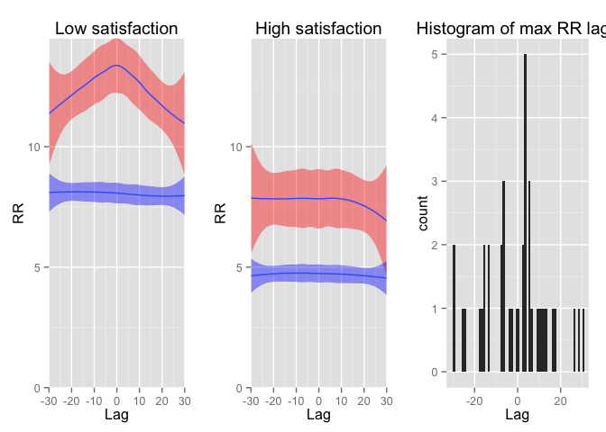
Prove It’s Cool! Emotion Dynamics
This figure shows the patterns of recurrence between a mother and an adolescent child in expressed negative emotion across a number of lags.
In red we see the real data, and in blue we see shuffled data (representing the null).
When satisfaction was low there was a matching pattern. When it was high people showed no matching.
Figure from Alex Paxton’s github
From the manuscript: "An exploratory analysis of emotion dynamics between mothers and adolescents during conflict discussions"

Slide 6
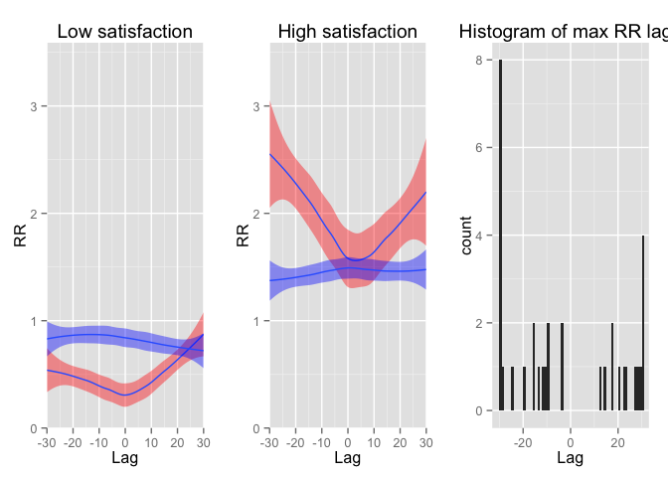
Prove It’s Cool! Emotion Dynamics
This figure shows the patterns of recurrence between a mother and an adolescent child in expressed interest across a number of lags.
In red we see the real data, and in blue we see shuffled data (representing the null).
When satisfaction was low recurrence was less than chance. When it was high people showed a turn-taking pattern.
Figure from Alex Paxton’s github
From the manuscript: "An exploratory analysis of emotion dynamics between mothers and adolescents during conflict discussions"

Slide 7
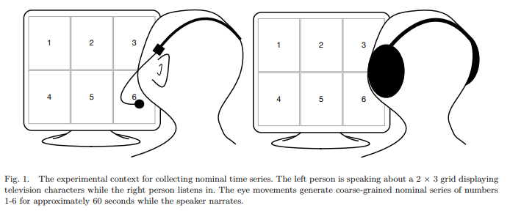
Prove It’s Cool! Eye Tracking
These people are looking at a screen divided into six parts (this can correspond to six figures / items)
One person talks the other through the image
Where they look is examined using CRQA
Figure from Dale, Warlaumont, & Richardson, 2011

Slide 8
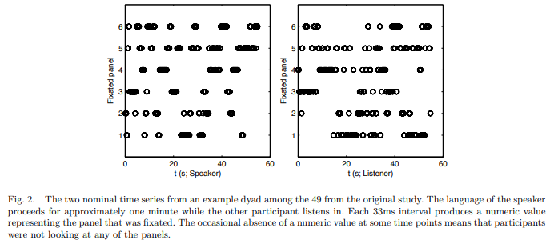
Prove It’s Cool! Eye Tracking
Figure from Dale, Warlaumont, & Richardson, 2011
Here you can see the raw data, which shows where they looked from time point to time point (33 ms intervals)

Slide 9
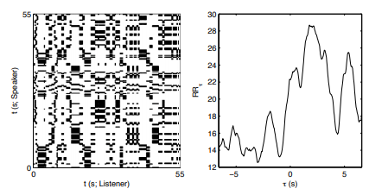
Prove It’s Cool! Eye Tracking
Here you can see a Cross Recurrence Plot (on the left) and the recurrence rate across different lags (on the right)
Note the highest peak is at a positive lag, indicating the leader-follower structure
Figure from Dale, Warlaumont, & Richardson, 2011

Slide 10
How CRQA Works

Slide 11
Recurrence Quantification Analysis
CRQA is the dyadic extension of Recurrence Quantification Analysis (RQA)
RQA is used with just one time series, to capture patterns of when a variable returns to the same state
Both CRQA and RQA can be used for continuous or categorical data
We are focusing on their application to categorical data
To use RQA or CRQA on continuous data, it is recommended that we do attractor reconstruction which is a bit heavy technically, and more than we need to cover today

Slide 12
Recurrence Plots
RQA is built around recurrence plots
These were originally just a way of visualizing complex patterns in time series
People eventually decided that it would be interesting to create quantitative metrics of certain interesting features of the plots
RQA is very new as a technique, so almost all the work done on it is exploratory
Currently there are 9 “standard” numbers people typically extract from a recurrence plot. One day more numbers might be extracted!

Slide 13
How Do They Work?
1
1
0
1
1
1
0
0
1
 | 0 | 1 | 1 | 0 | 0 | 0 | 1 | 0 | 0
Person 2’s time series
Person 1’s time series

Slide 14
How Do They Work?
1
1
0
1
1
1
0
0
1 |  | x | x |  |  |  | x
 | 0 | 1 | 1 | 0 | 0 | 0 | 1 | 0 | 0
Place a point wherever the two time series match in values
Person 2’s time series
Person 1’s time series

Slide 15
How Do They Work?
1 |  | x | x |  |  |  | x
1 |  | x | x |  |  |  | x
0
1 |  | x | x |  |  |  | x
1 |  | x | x |  |  |  | x
1 |  | x | x |  |  |  | x
0
0
1 |  | x | x |  |  |  | x
 | 0 | 1 | 1 | 0 | 0 | 0 | 1 | 0 | 0
Place a point wherever the two time series match in values
Person 2’s time series
Person 1’s time series

Slide 16
How Do They Work?
1 |  | x | x |  |  |  | x
1 |  | x | x |  |  |  | x
0
1 |  | x | x |  |  |  | x
1 |  | x | x |  |  |  | x
1 |  | x | x |  |  |  | x
0
0
1 |  | x | x |  |  |  | x
 | 0 | 1 | 1 | 0 | 0 | 0 | 1 | 0 | 0
The diagonal line contains matching at LAG 0, or synchronous matching
Person 2’s time series
Person 1’s time series

Slide 17
How Do They Work?
1 |  | x | x |  |  |  | x
1 |  | x | x |  |  |  | x
0
1 |  | x | x |  |  |  | x
1 |  | x | x |  |  |  | x
1 |  | x | x |  |  |  | x
0
0
1 |  | x | x |  |  |  | x
 | 0 | 1 | 1 | 0 | 0 | 0 | 1 | 0 | 0
Just off the main diagonal are the LAG -1 and LAG +1 relationships
Person 2’s time series
Person 1’s time series

Slide 18
How Do They Work?
1 |  | x | x |  |  |  | x
1 |  | x | x |  |  |  | x
0
1 |  | x | x |  |  |  | x
1 |  | x | x |  |  |  | x
1 |  | x | x |  |  |  | x
0
0
1 |  | x | x |  |  |  | x
 | 0 | 1 | 1 | 0 | 0 | 0 | 1 | 0 | 0
Just off that are the LAG -2 and LAG +2 relationships
Continuing this, we can see that the plot captures relationships at EVERY POSSIBLE LAG
Person 2’s time series
Person 1’s time series

Slide 19
How Do They Work?
1 |  | x | x |  |  |  | x
1 |  | x | x |  |  |  | x
0
1 |  | x | x |  |  |  | x
1 |  | x | x |  |  |  | x
1 |  | x | x |  |  |  | x
0
0
1 |  | x | x |  |  |  | x
 | 0 | 1 | 1 | 0 | 0 | 0 | 1 | 0 | 0
We can create a profile of the synchrony between people by counting up the points at each lag.
Since there are different amounts of cells, we covert them to a percentage.
Lag -2 | Lag -1 | Lag 0 | Lag +1 | Lag +2
3 / 7 | 2 / 8 | 0 / 10 | 2 / 8 | 2 / 7
0.43 | 0.25 | 0.00 | 0.25 | 0.29

Slide 20
Profile Plots
High recurrence at Lag -2
Person 1 leading Person 2
0.43 | 0.25 | 0.00 | 0.25 | 0.29

Slide 21
Profile Plots
No recurrence at Lag 0
Matching in the moment
0.43 | 0.25 | 0.00 | 0.25 | 0.29

Slide 22
Profile Plots
High recurrence at Lag +2
Person 2 leading Person 1
0.43 | 0.25 | 0.00 | 0.25 | 0.29

Slide 23
Profile Plots
Overall:
Turn-taking structure
One person experiences something, then other person matches after one or two time steps
0.43 | 0.25 | 0.00 | 0.25 | 0.29

Slide 24
Real Example: Emotion Dynamics
This figure shows the patterns of recurrence between a mother and an adolescent child in expressed interest across a number of lags.
When satisfaction was low recurrence was less than chance. When it was high people showed a turn-taking pattern.
Figure from Alex Paxton’s github
From the manuscript: "An exploratory analysis of emotion dynamics between mothers and adolescents during conflict discussions"

Slide 25
Quantifying the Plot
Profile plots are essentially giving the same information as a Cross Correlation, but for categorical data
We can also calculate statistics that relate to the entire plot
Recurrence Rate: proportion of squares that are filled in
This example: 18 / 84 = 0.21
1 |  | x | x |  |  |  | x
1 |  | x | x |  |  |  | x
0
1 |  | x | x |  |  |  | x
1 |  | x | x |  |  |  | x
1 |  | x | x |  |  |  | x
0
0
1 |  | x | x |  |  |  | x
 | 0 | 1 | 1 | 0 | 0 | 0 | 1 | 0 | 0

Slide 26
Diagonal lines
Diagonal lines have special importance in recurrence plots
Diagonals correspond to relationships at different lags
Continuous diagonal lines therefore correspond to extended periods of matching at some lag
1 |  | x | x |  |  |  | x
1 |  | x | x |  |  |  | x
0
1 |  | x | x |  |  |  | x
1 |  | x | x |  |  |  | x
1 |  | x | x |  |  |  | x
0
0
1 |  | x | x |  |  |  | x
 | 0 | 1 | 1 | 0 | 0 | 0 | 1 | 0 | 0
Person 1 entered state 1, then stayed there for two beats.
After two beats, Person 2 entered state 1, then stayed there for two beats

Slide 27
Diagonal lines
Most of the CRQA metrics are built around diagonal lines
This means they try to capture periods of extended coordination
Percent Determinism: the proportion of points that are in diagonal lines
In this example: 6 / 18 = 0.33
1 |  | x | x |  |  |  | x
1 |  | x | x |  |  |  | x
0
1 |  | x | x |  |  |  | x
1 |  | x | x |  |  |  | x
1 |  | x | x |  |  |  | x
0
0
1 |  | x | x |  |  |  | x
 | 0 | 1 | 1 | 0 | 0 | 0 | 1 | 0 | 0

Slide 28
Diagonal lines
Number of Lines: how many diagonal lines are there! (here there are 3)
Maximum Line Length: what is the length of the longest line! (here it is 2)
Average Line Length: what is the average length of the diagonal lines! (here it is 2)
1 |  | x | x |  |  |  | x
1 |  | x | x |  |  |  | x
0
1 |  | x | x |  |  |  | x
1 |  | x | x |  |  |  | x
1 |  | x | x |  |  |  | x
0
0
1 |  | x | x |  |  |  | x
 | 0 | 1 | 1 | 0 | 0 | 0 | 1 | 0 | 0

Slide 29
Diagonal lines
Entropy: this is a measure of disorder, based on Shannon’s information theory. It is essentially a measure of variability in the lengths of all the diagonal lines.
Only used for lines longer than the minimum (2 points).
In this example, it’s 0.
1 |  | x | x |  |  |  | x
1 |  | x | x |  |  |  | x
0
1 |  | x | x |  |  |  | x
1 |  | x | x |  |  |  | x
1 |  | x | x |  |  |  | x
0
0
1 |  | x | x |  |  |  | x
 | 0 | 1 | 1 | 0 | 0 | 0 | 1 | 0 | 0

Slide 30
Diagonal lines
Normalized Entropy: this is Shannon Entropy, normalized across numbers of lines in the plot. It can be useful for making comparisons across different systems.
If you are doing regressions, probably just pick one of ENTR or normalized ENTR.
1 |  | x | x |  |  |  | x
1 |  | x | x |  |  |  | x
0
1 |  | x | x |  |  |  | x
1 |  | x | x |  |  |  | x
1 |  | x | x |  |  |  | x
0
0
1 |  | x | x |  |  |  | x
 | 0 | 1 | 1 | 0 | 0 | 0 | 1 | 0 | 0

Slide 31
Vertical Lines
Vertical lines indicate when a person entered a state, and then another person entered that state and stayed there.
These are used less often, but may be interesting in certain cases.
Thought of as “trapping” the other person in the state you were in
1 |  | x | x |  |  |  | x
1 |  | x | x |  |  |  | x
0
1 |  | x | x |  |  |  | x
1 |  | x | x |  |  |  | x
1 |  | x | x |  |  |  | x
0
0
1 |  | x | x |  |  |  | x
 | 0 | 1 | 1 | 0 | 0 | 0 | 1 | 0 | 0

Slide 32
Vertical Lines
Laminarity: proportion of points in vertical lines. (here 15 / 18 = .83)
Trapping Time: average length of vertical lines. (here 2.5)
1 |  | x | x |  |  |  | x
1 |  | x | x |  |  |  | x
0
1 |  | x | x |  |  |  | x
1 |  | x | x |  |  |  | x
1 |  | x | x |  |  |  | x
0
0
1 |  | x | x |  |  |  | x
 | 0 | 1 | 1 | 0 | 0 | 0 | 1 | 0 | 0

Slide 33
All the CRQA Parameters
Parameter | Description
Recurrence Rate (RR) | Proportion of plot with a recurrence point
Percent Determinism (DET) | Proportion of points in a diagonal line
Number of Lines (NRLINE) | Number of diagonal lines
Maximum Line Length (maxL) | Maximum diagonal line length (thought to indicate strength of strongest attractor)
Average Line Length (L) | Average length of diagonal lines
Entropy (ENTR) | Variability in diagonal line lengths
Normalized Entropy (rENTR) | Variability in diagonal line lengths, normalized by number of lines in the plot
Laminarity (LAM) | Proportion of points in a vertical line
Trapping Time (TT) | Average length of vertical lines

Slide 34
Multiple Categories
With multiple categories, you only insert points for exact matches.
You can use as many categories as you want.
Here’s an example with 3 categories!
2 |  |  | x |  |  | x | x | x
2 |  |  | x |  |  | x | x | x
1 |  |  |  | x | x |  |  |  |  | x
2 |  |  | x |  |  | x | x | x
1 |  |  |  | x | x |  |  |  |  | x
2 |  |  | x |  |  | x | x | x
3 | x | x |  |  |  |  |  |  | x
3 | x | x |  |  |  |  |  |  | x
1 |  |  |  | x | x |  |  |  |  | x
1 |  |  |  | x | x |  |  |  |  | x
 | 3 | 3 | 2 | 1 | 1 | 2 | 2 | 2 | 3 | 1

Slide 35
EXAMPLE

Slide 36
Emily’s Data
Raw Skin Conductance
Categorical Skin Conductance

Slide 37
Moderate Matching
RAW Categorical
CRQA

Slide 38
Very Matchy
Raw Categorical
CRQA

Slide 39
Sparse Matching
Raw Categorical
CRQA

Slide 40
Profiles
No obvious overall trend for skin conductance matching profiles
Lots of variability across dyads

Slide 41
Profiles by Moderators
When women have low coping, their skin conductance FOLLOWS men’s
When women have medium coping, men’s skin conductance FOLLOWS them

Slide 42
Profiles by Moderators 2
When men have medium influence, skin conductance has a TURN TAKING structure

Slide 43
Inferential Statistics for Profiles
Main, Paxton, and Dale fit a structural equation model with latent quadratic terms
They used the significance of the quadratic term as a significance test to see whether there was something interesting going on in the profile plots
That’s more than we can cover today, however Alex Paxton put all her code online at github
https://github.com/a-paxton/emotion-dynamics
You could also just correlate variables with RR at different lags

Slide 44
CRQA Stats
Many CRQA parameters are highly correlated
Here ENTR is highly correlated with 4 other measures

